Slide 1
Gene Regulation in Prokaryotes

Slide 2
Introduction
All cells in an organism contain all the DNA: - Genes – all genetic information.
Must regulate or control which genes should be turned on in which cells.
Genes turned on determines cell functions – E.g. liver cells express genes for liver enzymes but not the genes for stomach enzymes.

Slide 3
Gene Expression
All the activities of an organism are controlled by genes.
Most of the genes of an organism express themselves by producing proteins.
The genes which produce proteins are called structural genes or cistrons.
Every cell of an organism posses all the genes, but all of them are not functional all the time.
If all the genes function all the time, enzymatic commotion will prevail or confusion in the cell metabolism.

Slide 4
In eukaryotes only a few genes are functional and all other genes are permanently shut off.
E. coli bacterium expresses only some of its genes at any given time out of the total of about three thousand genes.
Various mechanisms exist in the cell, which control and regulate the expression of genes.
The regulatory system turns the genes “on” when needed and turns “off’ when not needed.

Slide 5
Gene regulation
Gene regulation is the process of controlling genes in a cell's DNA which are expressed.
Different cells in a multicellular organism may express very different sets of genes, even though they contain the same DNA.
The set of genes expressed in a cell determines the set of proteins it contains, giving it its unique properties.
In eukaryotes like humans, gene expression involves many steps, and gene regulation can occur at any of these steps. However, many genes are regulated primarily at the level of transcription.

Slide 6
For example, one of the jobs of the liver is to remove toxic substances like alcohol from the bloodstream.
To do this, liver cells express genes encoding subunits of an enzyme called alcohol dehydrogenase.
This enzyme breaks alcohol down into a non-toxic molecule.
The neurons in a person's brain don’t remove toxins from the body, so they keep these genes unexpressed, or “turned off.”
Similarly, the cells of the liver don’t send signals using neurotransmitters, so they keep neurotransmitter genes turned off.

Slide 7
Gene Regulation in Prokaryotes by activators and repressors
In prokaryotes, the operon model of gene regulation is widely accepted.
Operon is a unit of bacterial gene expression and regulation, including structural genes and control elements of the gene expression.
Thus operon is a model which explains the on-off mechanism of protein synthesis in a systematic manner.
There are 2 types of regulators regulate gene expression.
They are positive regulators called activators and negative regulators called repressors.

Slide 8
Negative Regulators or Repressors
The repressor or inhibitor protein binds to the target site (operator) on DNA.
These block the RNA polymerase enzyme from binding to the promoter, thus preventing the transcription.
The repressor binds to the site where it overlaps the polymerase enzyme.
Thus, activity of the genes is turned off. It is called negative control mechanism.

Slide 9
Inducible Operon
An anti-repressor or anti-inhibitor called inducer is needed to inactivate the repressor and thereby activating the genes.
Thus, the genes are switched on. This is demonstrated by lactose operon.
Lac operon contains genes that encode enzymes responsible for lactose metabolism.
In bacteria, operon refers to a group of closely linked genes which act together and code for the various enzymes of a particular biochemical pathway.

Slide 10
The model of lac operon of E. coli
Structural Genes
Promoter Gene
Operator Gene
Regulator Gene

Slide 11
Structural Genes
There are three structural genes of the lac operon i.e. lac Z, lac Y and lac A. The main function of structural genes is to control of protein synthesis through messenger RNA. Function of these genes is as follows.
(i) lac Z:
It encodes the enzyme beta-galactosidase, which catalyses the breakdown of lactose into glucose and galactose.
(ii) lac Y:
It encodes the enzyme galactosidase permease, which permits entry of lactose from the medium into the bacterial cell.
(iii) lac A:
It encodes the enzyme transacetylase.

Slide 12
Promoter Gene
The above three structural genes under the control of the promoter gene [designated P].
In the promoter, RNA polymerase binds to the DNA and prepares to initiate transcription.
The main function of promoter gene is to initiate mRNA transcription.

Slide 13
Operator Gene
The other regulatory element in an operon is the operator (designated O).
This is the element that determines whether or not the genes of the operon should be transcribed.
The main function of operator gene is to control function of structural genes.

Slide 14
Regulator Gene
This is designated as I.
It is expressed all the time, or constitutively and plays an important role in operon function.
This is the lac I gene, which encodes a protein called the lac repressor.
The lac repressor has two functional domains or regions: one that binds to the operator region of the gene, and one that binds to lactose.

Slide 16
When the repressor binds to the operator, it prevents RNA polymerase advancing along the operon, and transcription does not occur.
The regulation of the operon depends on regulating whether or not the repressor binds to the operator.
The function of regulator gene is to direct synthesis of repressor, a protein molecule.

Slide 17
When Lactose is absent
When the lactose is absent in the environment, events take place in this way.
The lac I gene is transcribed [constitutively i.e. continuously] and the mRNA is translated, producing the lac repressor.
The repressor binds to the operator, and blocks RNA polymerase.
When RNA polymerase is blocked, there is no transcription.
Thus the enzymes for lactose metabolism are not synthesized, because there is no lactose to metabolize.
Thus when lactose is absent, lactose-metabolizing enzymes are not produced.

Slide 18
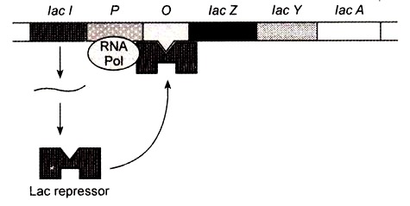

Slide 19
When Lactose is Present
When the lactose is present in the environment, the events occur in a different way.
A small amount of the lactose enters into the cell and affects regulation of the operon.
The lac repressor synthesized can bind to lactose.
After binding to lactose, the repressor undergoes a conformational change (change of shape).
Molecules that change shape when they bind to another molecule are called allosteric molecules.
With this change, the lac repressor is unable to bind to the operator region.
Hence RNA polymerase is not blocked, and is able to transcribe the genes of the operon.

Slide 20
The enzymes encoded by those genes are produced.
The lac permease transports more lactose into the cell and beta-galactosidase cleaves the lactose into glucose and galactose.
This can be further metabolized by other enzymes, producing energy for the cell.
Lactose, therefore, is able to induce the synthesis of the enzymes necessary for its metabolism (by preventing the action of the repressor).
As such, lactose is the inducer of the lac operon.
Thus when lactose is absent, lactose-metabolizing enzymes are not produced, and when lactose is present, those enzymes are produced.

Slide 21
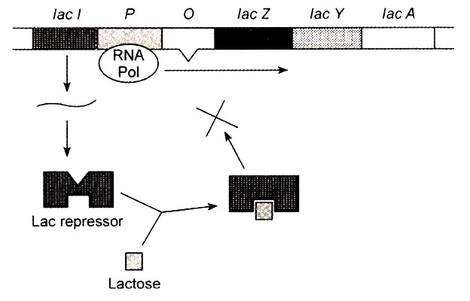

Slide 22
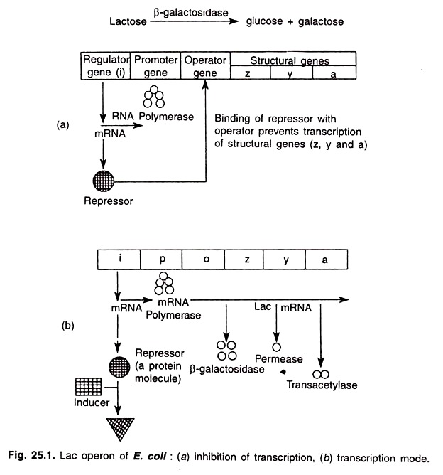

Slide 23
Repressible Operon
Repressible operons are regulated by the end product of the metabolic pathway and not by a reactant in the metabolic pathway (such as lactose in lac operon).
An example of repressible operon is the Trp operon.
This encodes enzymes which are responsible for the synthesis of the amino acid tryptophan (trp for short).
The trp operon is regulated by trp, which is the product of the metabolic pathway.

Slide 24
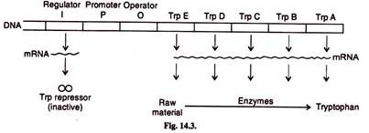
Tryptophan is synthesized in five steps, each step requiring a particular enzyme.
The genes for encoding these enzymes lie adjacent to one another, called trp E, trp D, trp C, trp B and trp A.

Slide 25
In trp operon, the trp repressor only binds to the operator when trp is present.
The repressor binds to trp, and undergoes a conformational change [change of shape].
This change in shape allows it to bind to the operator, blocking transcription.
Because trp is needed for repression, it is referred to as a co-repressor in this system. (as opposed to lactose being an inducer).
When trp is absent, the repressor will not bind to the operator, and transcription occurs.
Thus, if there is plenty of trp around, the transcription is blocked.
If there is no trp around [it needs to be synthesized], transcription occurs.
In other words, it allows production of the enzymes for trp synthesis.

Slide 26
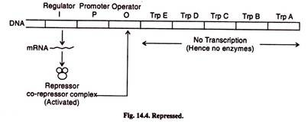

Slide 27
